Slide 1

Title:
Peptidylprolyl Cis/Trans Isomerases Parvulin 14 and Parvulin 17 Bind Both to Hepatitis B Virus Core Protein and Core Particle and Enhance HBV Replication
Presenter Name (Prof . Dr. Umar Saeed)
International Center of Medical Sciences Research
(ICMSR), PAKISTAN
Foundation University Islamabad PAKISTAN.
Notes:
BEISMIALLAHERAHMANERAHEEM

Slide 2
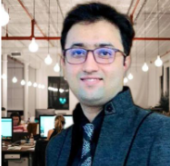
My Interest and Objectives:
I am an enthusiastic and dedicated professional.
I strongly believe in Unity, Faith & Discipline.
Professionalism, Competence, Self-development and Leadership
Strong Leadership Profile
RANKED in Top 3% Scientists-Globally
Background
With over 15 years of experience in global health, molecular medicine, microbiology, applied health sciences research and academia as:
Managing Director, Chief Research, Professor, Principal Lead, and Consultant
I have led phase 3 clinical trials and spearheaded the COVID-19 vaccine during time of pandemic.
Notes:
BEISMIALLAHERAHMANERAHEEM

Slide 3
International Publications:
  200 research articles in renowned journals (The Lancet, JAMA Oncology, Lancet HIV, & Several Top Ranked Journals),
  Impact factor of 4,000
  8566 citations,
  i10-index 73
International Awards & Scholarships:
  I have received over 28 international awards and scholarships.
Workshops & Trainings:
  I have presented and attended over 200 workshops, and trainings.
Notes:
BEISMIALLAHERAHMANERAHEEM

Slide 4
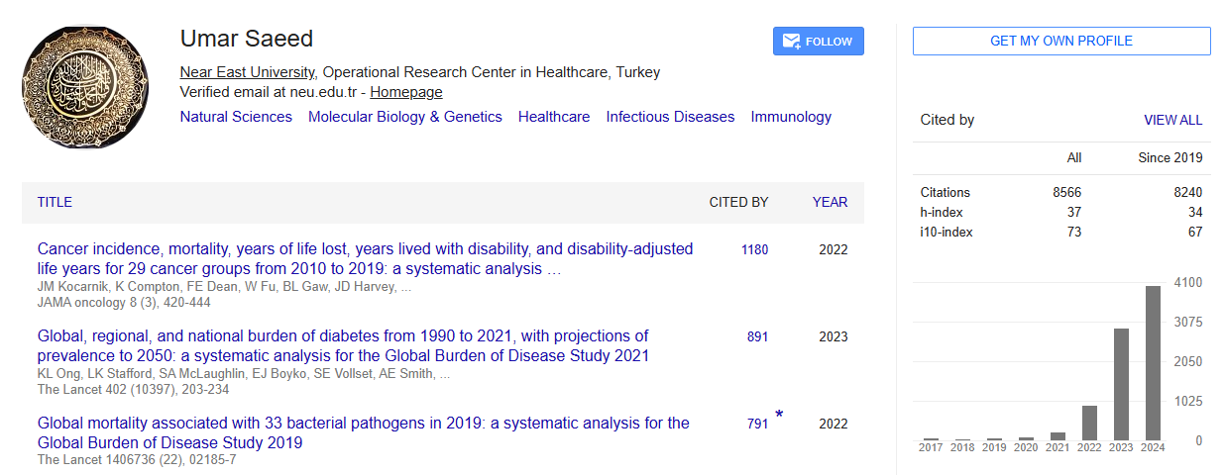
Notes:
BEISMIALLAHERAHMANERAHEEM

Slide 5
Peptidylprolyl Cis/Trans Isomerases Parvulin 14 and Parvulin 17 Bind Both to Hepatitis B Virus Core Protein and Core Particle and Enhance HBV Replication
Notes:
BEISMIALLAHERAHMANERAHEEM

Slide 6
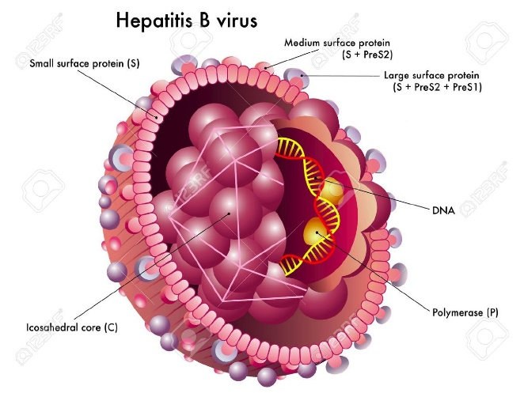
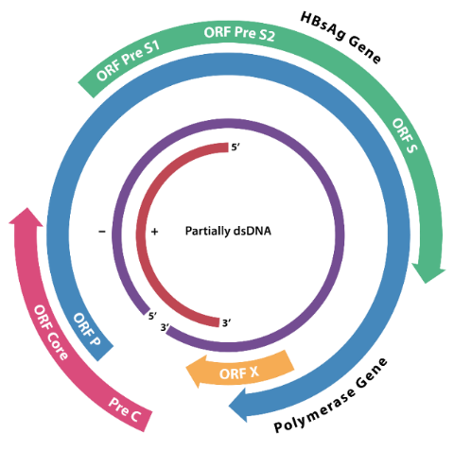
Hepatitis B Virus
Human hepatitis B virus (HBV)
  Hepadnaviridae family
  infects hepatocytes
HBV causes
  Acute and chronic disease
  Cirrhosis
  Hepatocellular carcinoma
According to WHO, 257 million people around the world are living with chronic CHB resulting in 887,000 deaths per year
The genome organization of HBV
https://en.wikipedia.org/wiki/Hepatitis_B_virus
Notes:
BE ISM MI ALLAH E RAHMAAAN E RAHEEM
The core (C) gene encodes the capsid protein. The P gene codes for the viral polymerase. The X gene gives rise to a protein of not completely understood function. The three envelope proteins are encoded by a single ORF with three in frame start codons.

Slide 7
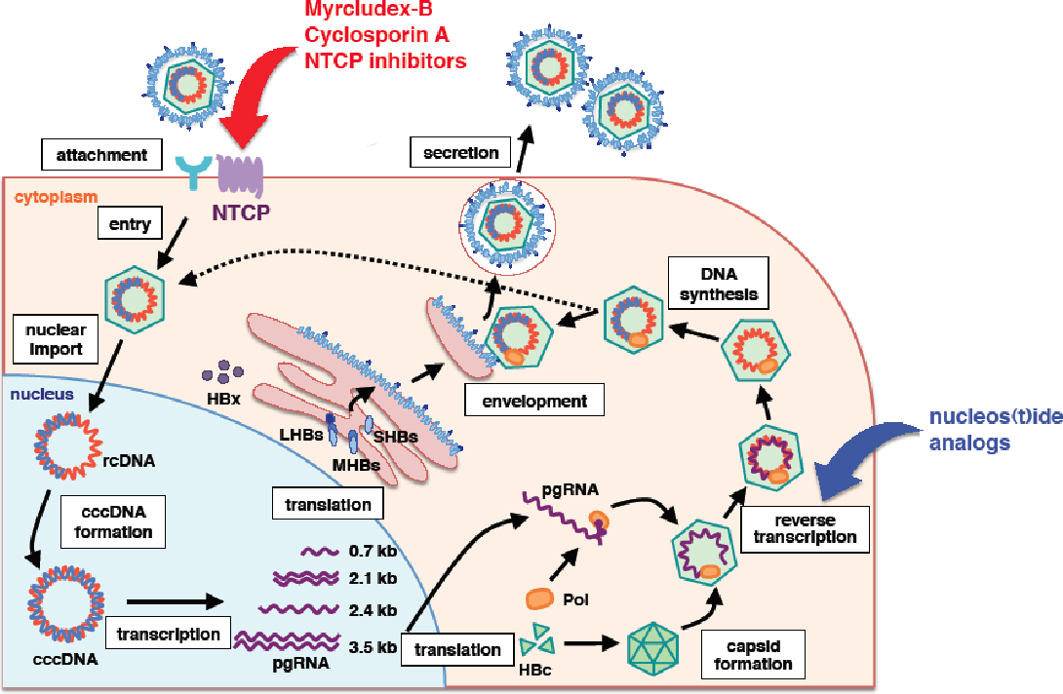
HBV Life Cycle
Na⁺-Taurocholate Co-transporting Polypeptide (NTCP) Receptor in the liver
Watashi K et al., Int J Mol Sci. 2014 15(2): 2892-2905
Notes:
BE ISM MI ALLAH E RAHMAAAN E RAHEEM

Slide 8
HBV cccDNA
Template of viral transcription
Viral reservoir for persistence
Nassal, 2015 Gut;0:1–13
Notes:
BE ISM MI ALLAH E RAHMAAAN E RAHEEM

Slide 9
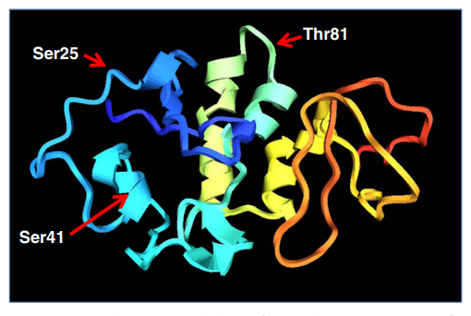
HBx Protein
Transcriptional transactivator
Essential for HBV life cycle and host-virus interactions
Stimulates viral replication
Hernández, et al Infect Agent Cancer. 2012; 7: 27.
Notes:
BE ISM MI ALLAH E RAHMAAAN E RAHEEM

Slide 10
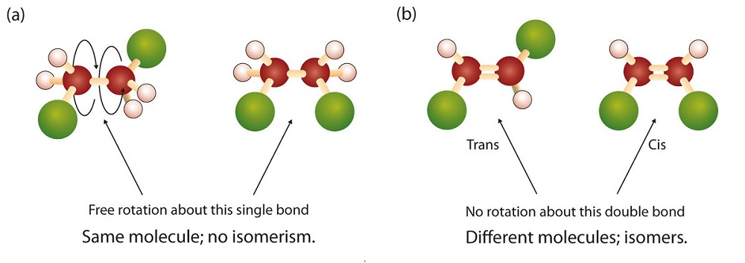
Peptidyl prolyl cis/trans isomerases (PPIases)
Cis-trans isomerization of Xaa-Pro peptide bonds
Role in protein folding by twisting the backbone of target proteins
Three subfamilies
  Cyclophilins
  FK506-binding proteins
  Parvulins
  &
  Protein Ser/Thr phosphatase 2A (PP2A) activator (PTPA)
Cis
Trans
Terada et al., 2001 J MolBiol, 305:917-926
Kessler D et al., 2007 BMC Biology,; 5:37
Notes:
BE ISM MI ALLAH E RAHMAAAN E RAHEEM
Briefly, I shall describe PPIases, since I have explained many times before.
PPIases do Cis/Trans at XP motif of target proteins and are involved in protein folding.
They have 3 subfamilies including parvulins.

Slide 11
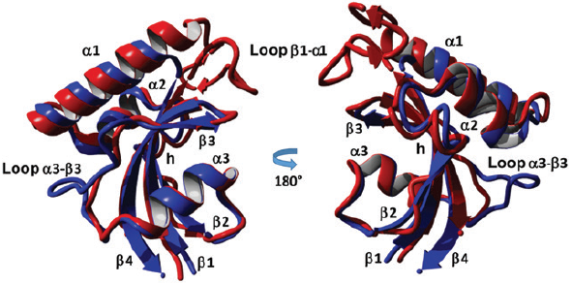
Parvulins
Class III of PPIases are conserved from bacteria to man
Functions in critical cellular processes such as mitotic regulatory mechanisms and cell proliferation
Human genome contains two parvulin genes:
  Peptidyl-prolyl cis-trans isomerase NIMA-interacting 1 (PIN1)
  Peptidyl-prolyl cis-trans isomerase NIMA-interacting 4 (PIN4) Parvulin14/17
Pin1 (Red)
Par14 (Blue)
Matena et al., Bio Chem 2018; 399(2): 101–125
Notes:
BE ISM MI ALLAH E RAHMAAAN E RAHEEM

Slide 12
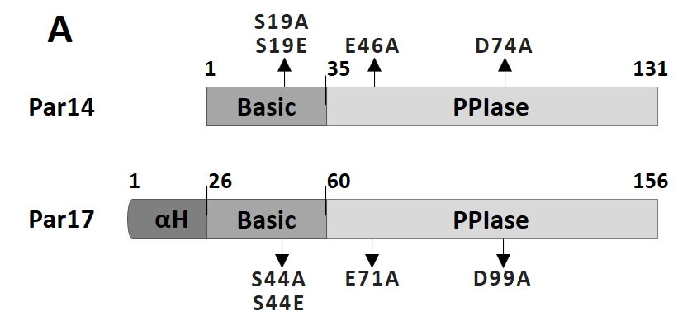
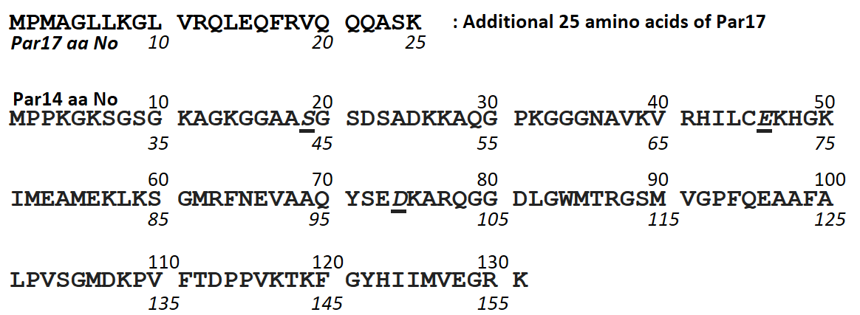
Par14/Par17
Par14, involved in cell cycle progression, chromatin remodeling and ribosome biogenesis
Par17 contains 25 additional, N-terminal amphipatic α-helix domain by alternative transcription initiation
Terada et al., 2001 J MolBiol, 305:917-926
Notes:
BE ISM MI ALLAH E RAHMAAN E RAHEEM.

Slide 13
Par14/Par17
Par14/Par17 occurs in nucleus, cytosol and mitochondria
Par14/Par17 binding occurs at RP, KP or HP sites in substrate
In contrast to Par17, the Par14 displays very weak PPIase activity towards peptidic substrates
Kessler D et al., 2007 BMC Biology,; 5:37
Notes:
BE ISM MI ALLAH E RAHMAAN E RAHEEM.

Slide 14
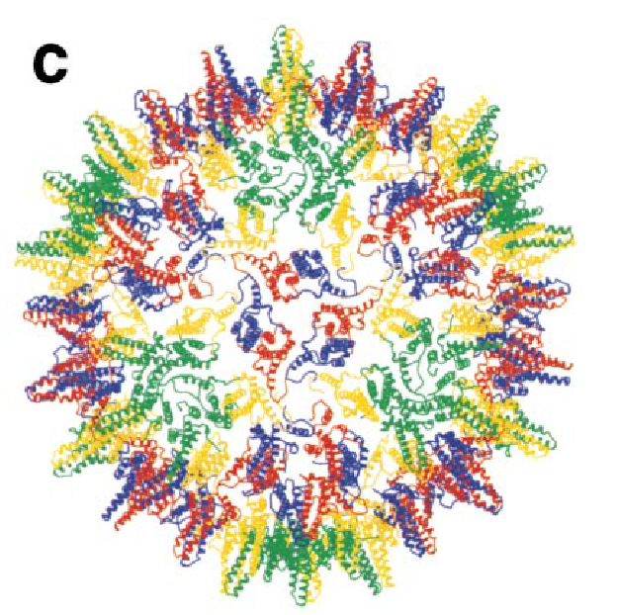
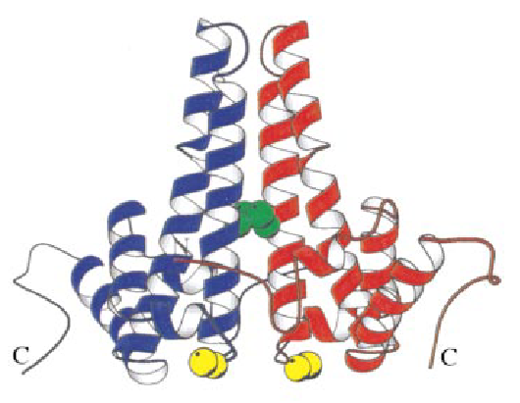
HBc Protein
The HBc consists of 183 or 185 amino acids (depending on the strains)
Assemble to core particle (180 or 240 HBc), which is capable of incorporating pre-genomic (pgRNA) and reverse transcriptase.
HBc protein
HBV C protein dimer
HBV core particle
RP
140
1
185
149
Assembly domain (N-terminal domain)
Linker domain
Nucleic acid binding domain (C-terminal domain)
Molecular Cell, 1999 (3), 771-780
Notes:
BE ISM MI ALLAH E RAHMAAAN E RAHEEM
Hbc assembles to core particle, which is capable of pgRNA encapsidation and reverse transcriptase.
This is structure of HBc, consists of N-terminal Assembly, linker and C-terminal NA binding domain.
HBc monomers associate into dimer and several dimers assemble to form core particle.

Slide 15
Materials and Methods
Vector construction
Cell culture, DNA transfection, and core particle immunoblotting
Stable cell lines
Northern, Southern, and nucleic acid blotting
SDS-PAGE and Western blotting
Juglone and PiB treatment
Cycloheximide treatment
Co-immunoprecipitation
HBV preparation and infection
cccDNA extraction and cccDNA chromatin immunoprecipitation
Notes:
BE ISM MI ALLAH E RAHMAAAN E RAHEEM

Slide 16
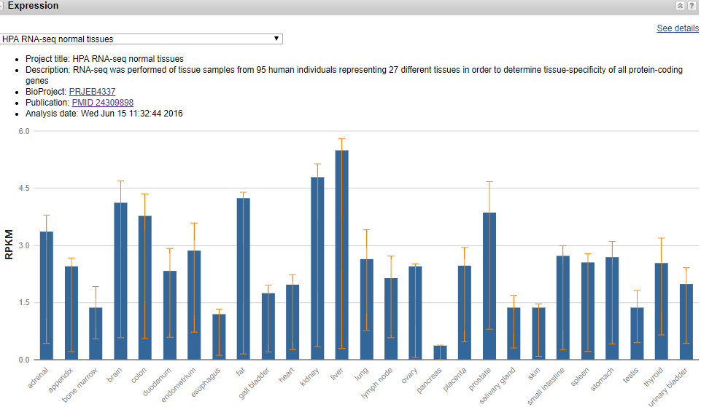
High expression of PIN4 gene in Liver
Reads Per Kilobase per Million mapped reads
https://www.ncbi.nlm.nih.gov/gene/5303
RPKM is a method of quantifying gene expression
Notes:
BE ISM MI ALLAH E RAHMAAAN E RAHEEM

Slide 17
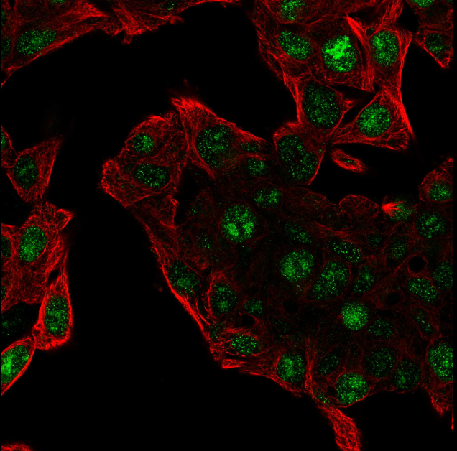
Human Protein Atlas
In HepG2 Hepatocellular carcinoma cell line
The PIN4 RNA expression was reported
considerably higher
https://www.proteinatlas.org/ENSG00000102309-PIN4/cell
Notes:
BE ISM MI ALLAH E RAHMAAAN E RAHEEM

Slide 18
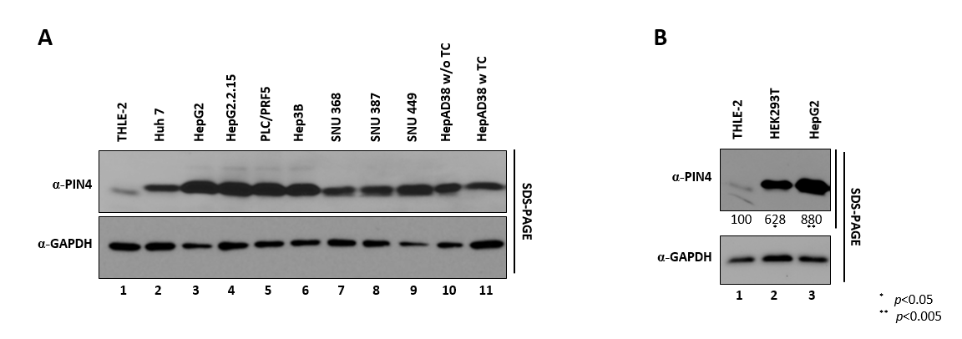
Higher expression of PIN4 in several human hepatocellular carcinoma and HBV replicating cell lines
We speculated that PIN4 or its products might affect HBV replication
THLE-2 immortalized human liver epithelial cells
Notes:
BE ISM MI ALLAH E RAHMAAAN E RAHEEM

Slide 19
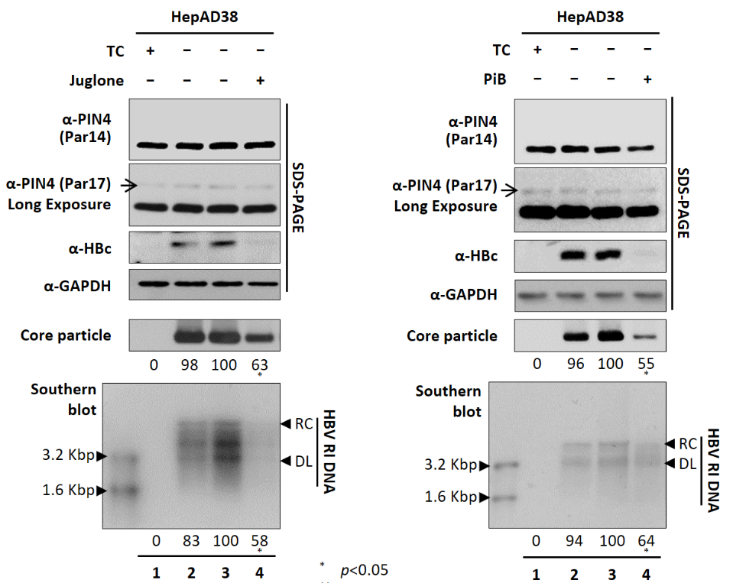

Parvulin inhibitors abrogate HBV replication
Juglone and PiB are Parvulin Inhibitors
Obtained similar results in HepG2.2.15, HepG2, and Huh7 cells
Notes:
BE ISM MI ALLAH E RAHMAAAN E RAHEEM

Slide 20
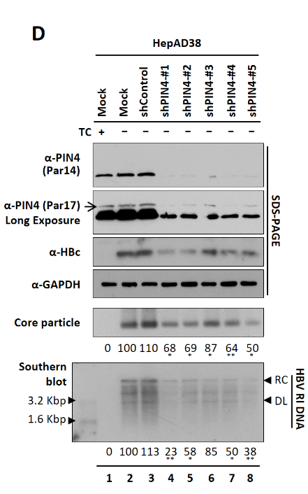
Knockdown of PIN4 abrogate HBV replication
Obtained similar results in
HepG2.2.15, HepG2, and Huh7 cells
Notes:
BE ISM MI ALLAH E RAHMAAAN E RAHEEM

Slide 21
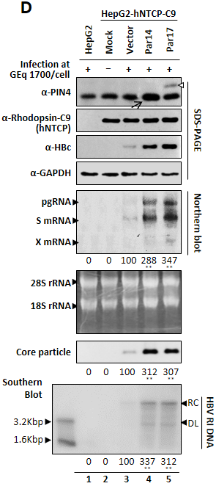
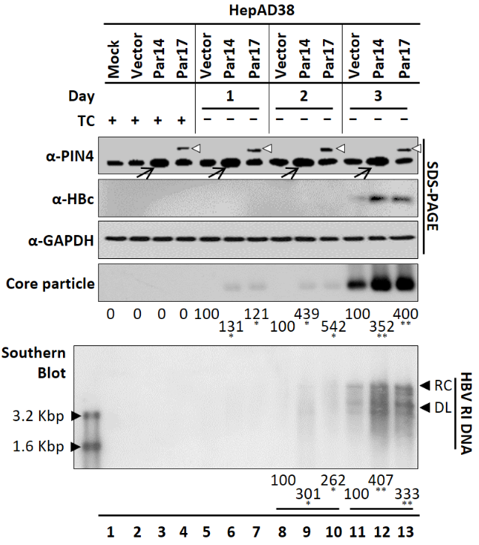
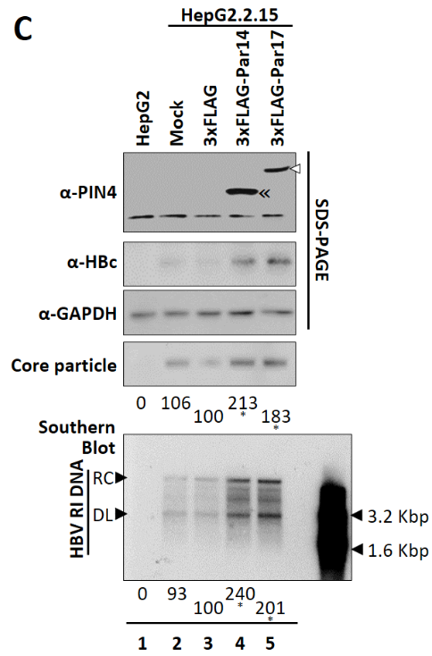
Par14/17 overexpression augment HBV replication
Obtained similar results in
HepG2, and Huh7 cells
Notes:
BE ISM MI ALLAH E RAHMAAN E RAHEEM.

Slide 22
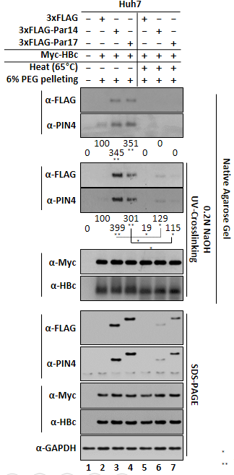
Par14/17 bind to both outside and inside the core particle
* p<0.05
** p<0.005
*** p<0.0005
Notes:
BE ISM MI ALLAH E RAHMAAAN E RAHEEM

Slide 23
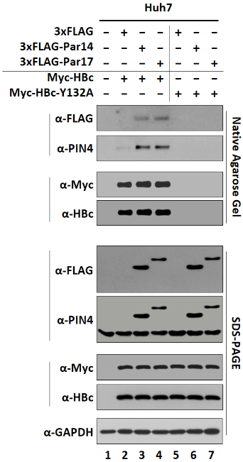
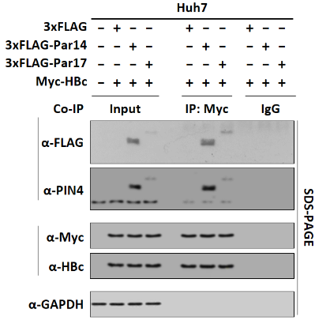
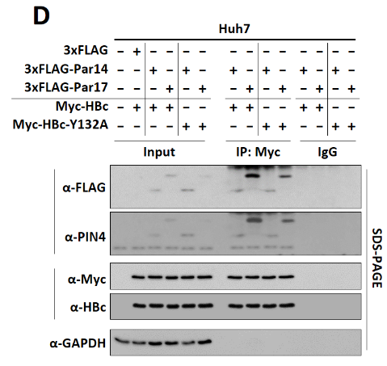
Par14/17 bind to both HBc and HBV core particle
Y132A is core particle deficient mutant of HBc
Notes:
Since Par14 and Par17 bind to RP motifs on HBx (Saeed U et al., JVI 2019), we reasoned that single RP motif on HBc may serve as a binding site for Par14/Par17.
Next, with native agarose gel electrophoresis and immunoblotting, we showed that Par14 and Par17 proteins bind onto core particle
BE ISM MI ALLAH E RAHMAAAN E RAHEEM

Slide 24
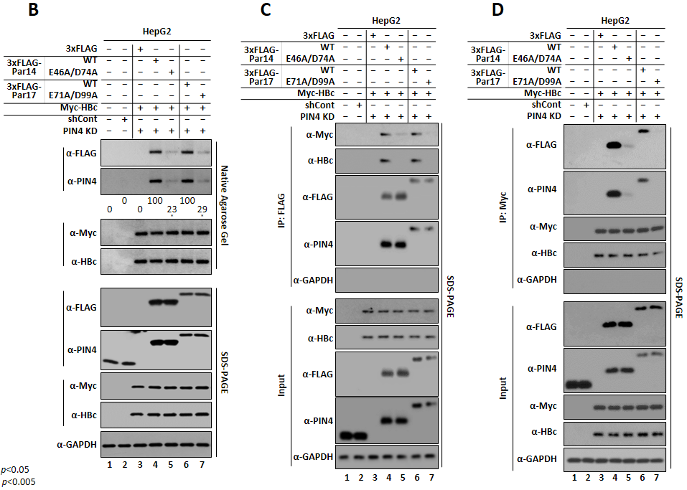
Catalytically active Par14/17 residues are crucial for interaction with HBc
Co-IP
Reciprocal
Co-IP
Substrate binding
deficient mutant
E46A/D74A of Par14
E71A/D99A of Par17
Notes:
Since the negatively charged substrate binding residues E46 and D74 of Par14 and E71 and D99 of Par17 interact with the RP motifs of HBx target protein
these substrate binding residues of Par14/Par17 may also bind to the RP motif in HBc and/or core particle.
BE ISM MI ALLAH E RAHMAAAN E RAHEEM

Slide 25
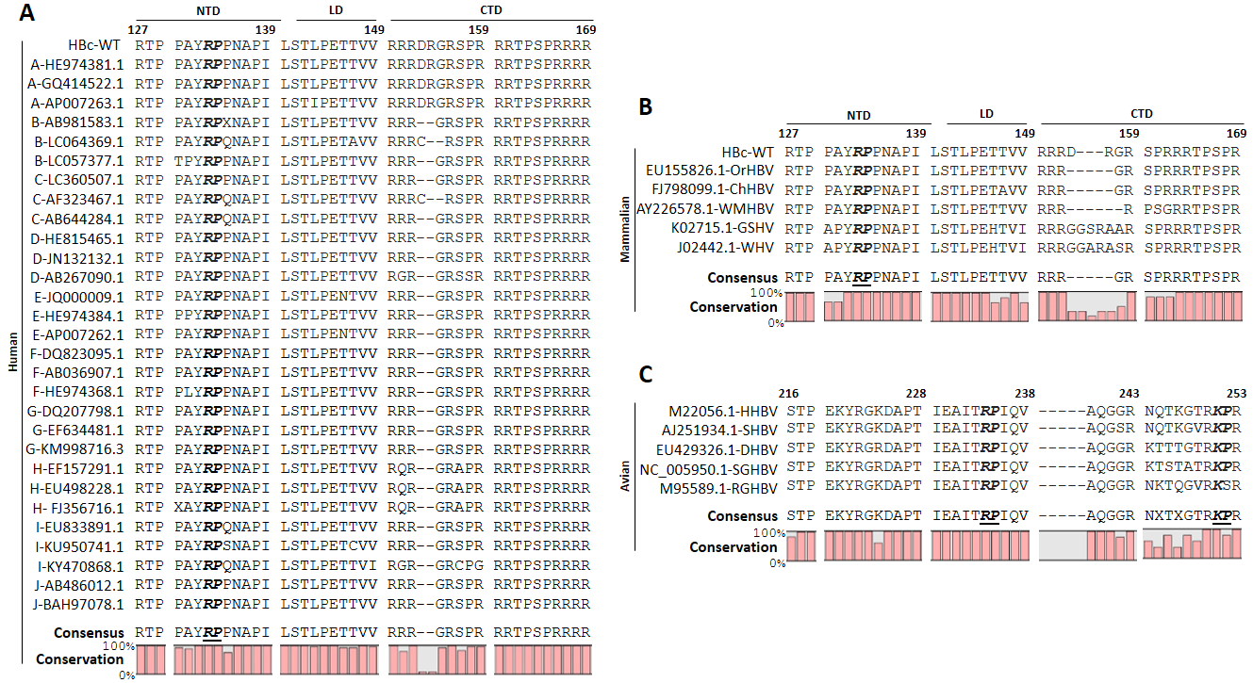
¹³³RP¹³⁴ motif conserved among human HBV genotypes and mammalian hepadnaviruses
Notes:
Because Par14/Par17 interact with HBc and core particle (Fig. 1 and 2), we reasoned that the positively charged amino acid preceding proline in HBc could be Par14/Par17–interaction site like those in HBx ). Sequence analysis of HBc revealed single ¹³³RP¹³⁴ motif in the HBc N-terminal domain
BE ISM MI ALLAH E RAHMAAN E RAHEEM.

Slide 26
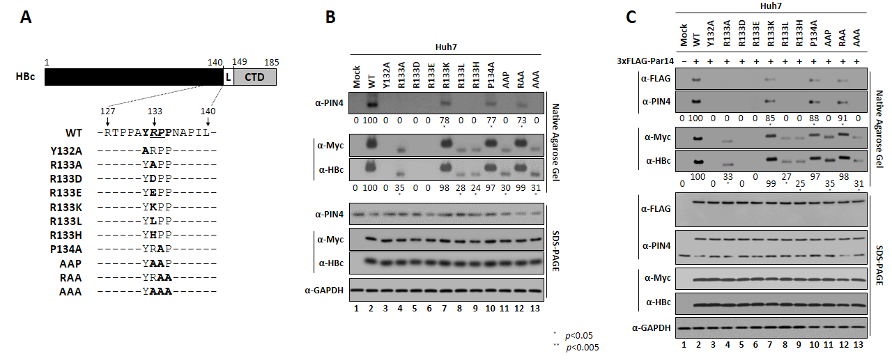
R133 of HBc is important for binding with Par14/Par17
Obtained similar results with Par17 transfected cells
Notes:
BE ISM MI ALLAH E RAHMAAN E RAHEEM.

Slide 27
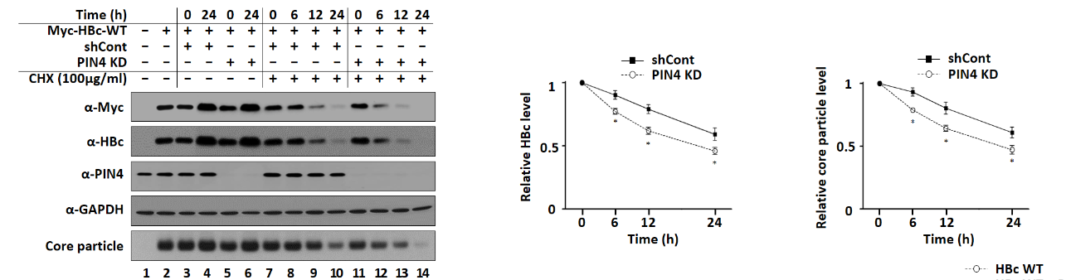
Knockdown of PIN4 decreases HBc and core particle stability
Huh7
Cycloheximide (CHX)
is protein synthesis inhibitors
Notes:
BE ISM MI ALLAH E RAHMAAAN E RAHEEM

Slide 28
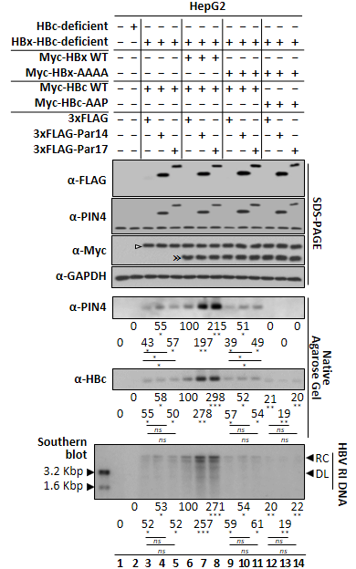
Besides HBx, HBc is also critical for Par14/Par17 mediated HBV replication
* p<0.05
** p<0.005
*** p<0.0005
Notes:
BE ISM MI ALLAH E RAHMAAAN E RAHEEM

Slide 29
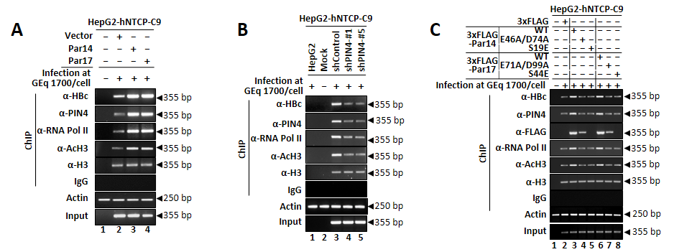
Par14/17 promotes recruitment of HBc onto HBV cccDNA
Obtained similar results in
HepAD38 cells
Notes:
BE ISM MI ALLAH E RAHMAAAN E RAHEEM

Slide 30
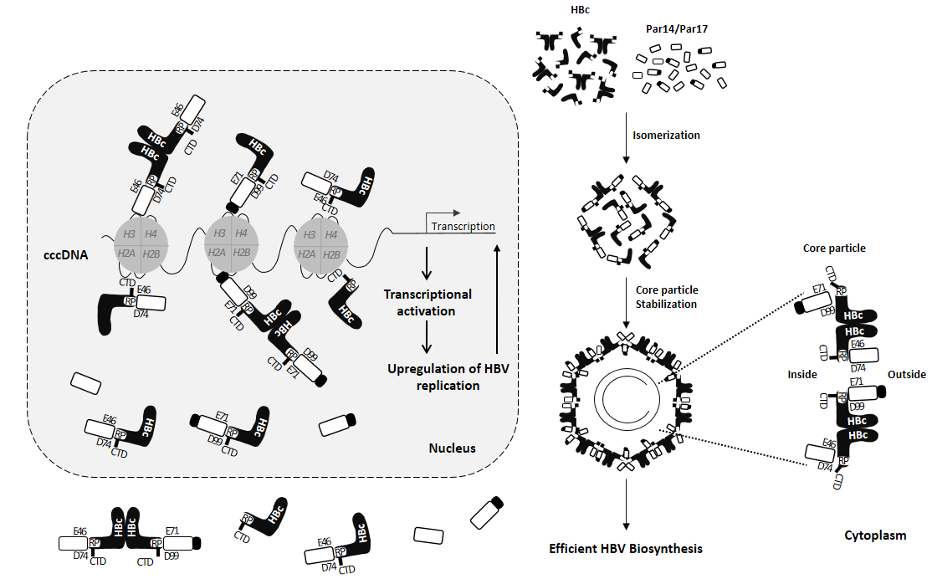
Model of Par14/17-HBc and core particle mediated HBV replication
Notes:
BE ISM MI ALLAH E RAHMAAAN E RAHEEM

Slide 31
Conclusions
We found for the first time that in the presence of HBx, the Par14/Par17 upregulates HBV replication from cccDNA, HBV RNA transcription and DNA synthesis, and virion secretion.
Par14/Par17 engage direct physical interactions with HBx, HBc and HBV core particles.
Par14/Par17 are recruited to cccDNA and activate chromatin for transcription activation through specific DNA-binding residues, while through catalytic active residues Par14/Par17 bind to HBx or HBc and promote their recruitment to cccDNA.
Taken together, our results suggest that Par14/Par17 inhibition or knockdown might be a new therapeutic option to functionally cure chronic hepatitis B, eventually to prevent hepatocarcinogenesis.
Notes:
BE ISM MI ALLAH E RAHMAAAN E RAHEEM

Slide 32
Benefits to Community
  Novel therapeutic option to functionally cure chronic hepatitis B, eventually to prevent hepatocarcinogenesis.
  Beneficial for Oncologists to examine molecular prospects.
  Potential to attract pharmaceutical companies to join collaborative initiatives internationally.
Notes:
BE ISM MI ALLAH E RAHMAAAN E RAHEEM

